Slide 1
Hospital Management System
Use-case Presentation Presented by : Group 5
Student ID:1005011
1005016
1005019
1005021
1005024

Slide 2
Outline of the presentation
Subsystems
Actors
Actor Glossary
According to each subsystems
Use-case Glossary
Use-case Diagram
Use-case Narrative with
High level table version &
Documentation

Slide 3
Sub-Systems
Registration System
Patient Management
Employee Management
Diagnostic center System
Billing System
Scheduling System

Slide 4
Actors
Receptionist
Doctor
Patient
Diagnostic Center Assistant
Clerk
Employee
Data Entry Manager
Diagnostic Center Manager
Human Resource Officer

Slide 5
Actors Glossary
Actor | Short-key | Activity Scope
Patient | PT | Register in the system, making appointment , receive treatment, request for medical test, pay bill
Human Resource officers | HRO | Receive duty schedule and distribute them to employees
Administrator | AD | Maintains the system , has access to every part of the system and some jobs are done only by him
Data Entry Manager | DEM | Enter and update database
Clerk | CLK | Collects bill
Receptionist | RCP | Registers a patient, schedule an appointment, assign bed or cabin, receive requests for tests
Diagnostic Center Manager | DCM | Maintains liaison between patient and diagnostic center
Diagnostic Center Assistant | DCA | Collects sample and prepare report
Doctor | DOC | Treats the patient, refer medical test , discharge a patient
Employee | EMP | Hospital employees

Slide 6
1. Registration System
Use-Case Glossary:
Use-case ID>Name | Description | Participant Actors and roles
1.1>Register Patient | PT completes the registration process by giving necessary information to RCP | PT,RCP
1.2>Prepare Current Patient List | AD will prepare the current patient list | AD
1.3>View Current Patient List | RCP,AD can see the current patient list | RCP,AD

Slide 7
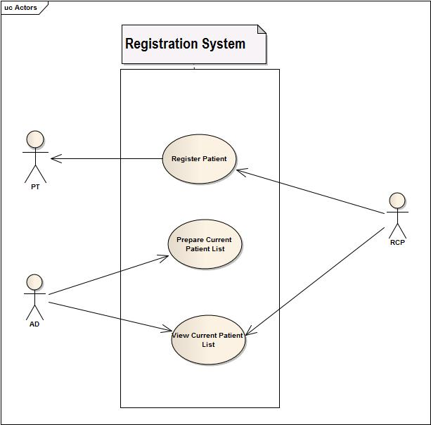
Fig : USE CASE diagram of Registration System

Slide 8
1.1 Register Patient (Use-Case Narrative)
USE CASE NAME | DEFINE ROUTE AND PRICE
USE CASE ID | 1.1
Priority | High
Primary Business Actor | Patient (PT)
External Receiver Actor | Receptionist (RCP)
Description | Receptionist takes the information of the patient and registers him in the system
Trigger | By Patient

Slide 9
Typical Course Of Events
Actor Action | System Response
Step 1. PT fill up the forms in hospital | Step 3. System creates an account
Step 2. RCP fills up the online form | Step 4. Sends user id and pw to PT

Slide 10
Documentation of the use-case 1.1
Course of the events
Conclusion:
Concludes when a patient is registered to the hospital information system.
Post-condition:
A doctor is assigned to the patient.
Implementation Issues:
Graphical User interface will be provided in the system software to be registered.

Slide 11
1.2 Prepare Patient list (Use-Case Narrative)
USE CASE NAME | DEFINE ROUTE AND PRICE
USE CASE ID | 1.2
Priority | Medium
Primary Business Actor | Admin (AD)
External Receiver Actor
Description | AD prepares a list of patients currently registered in the system
Trigger | AD

Slide 12
Typical Course Of Events
Actor Action | System Response
Step 1. AD asks the system to prepare a list of current PT | Step 2. System produces the list of PT who are currently admitted to the hospital

Slide 13
Documentation of the use-case 1.2
Course of the events
Conclusion:
Concludes when information about patients is currently stored and ready to be searched.
Post-condition:
The administrator is notified about the current patients
Implementation Issues:
List of patient information is stored in database and prepared for filter searching.

Slide 14
1.3 View Patient List (Use-Case Narrative)
USE CASE NAME | DEFINE ROUTE AND PRICE
USE CASE ID | 1.3
Priority | Low
Primary Business Actor
External Receiver Actor | RCP, AD
Description | Receptionist or AD can view the current patient list
Trigger | PT ,AD

Slide 15
Typical Course Of Events
Actor Action | System Response
Step 1. RCP wants to view the admitted PT list | Step 2 . System shows it

Slide 16
Documentation of the use-case 1.3
Course of the events
Conclusion:
Concludes when a full list of patients is showed on GUI of the system software.
Post-condition:
The administrator is notified about the current patients.
Implementation Issues:
List of patient information is stored in database and can be shown to the administrator by searching (perhaps with filter options).

Slide 17
2.Patient Management
Use-Case Glossary:
Use-case ID>Name | Description | Participant Actors and roles
2.1>Appointment Assign | PT goes to RCP and requests for an appointment, RCP checks the duty schedule of the DOC and makes an appointment | DOC,RCP,PT
2.2>Prepare Prescription | DOC will prepare electronic prescription | DOC
2.3>Update Patient Database | DEM will update the patient database by updating prescription and diagnostic information | DEM
2.4>Cabin/Bed Assign | PT requests for cabin/bed to RCP,RCP contacts with the AD and assigns a bed/cabin | PT,RCP,AD
2.5>Refer Medical Test | DOC requests diagnostic test to the DCM | DCM,DOC
2.6>Prepare Bill | CLK will prepare total bill for the patient and sends it to the billing subsystem | CLK
2.7>Discharge | DOC, CLK permits the PT to be discharged | PT,DOC,CLK

Slide 18
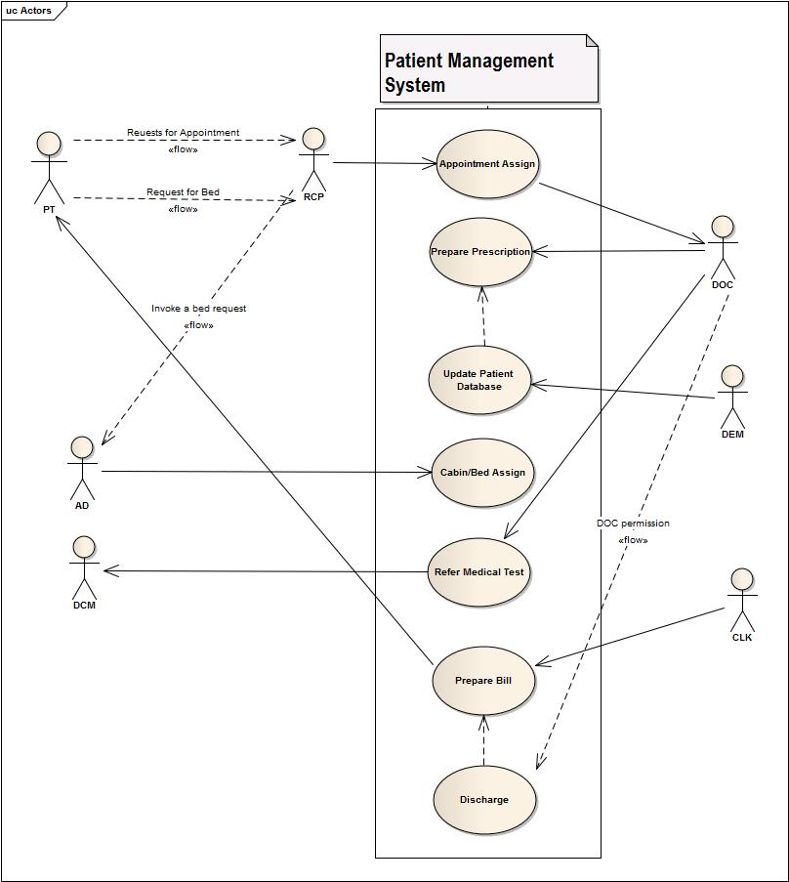
Fig : USE CASE diagram of Patient Management

Slide 19
2.1 Appointment Assign (Use-Case Narrative)
USE CASE NAME | DEFINE ROUTE AND PRICE
USE CASE ID | 2.1
Priority | Medium
Primary Business Actor | RCP
External Receiver Actor | Patient
Description | RCP assigns PT appointments
Trigger | RCP

Slide 20
Typical Course Of Events
Actor Action | System Response
Step 1. PT wants to visit a DOC | Step 3. System tells whether he is available or not
Step 2. RCP searches for availability | Step 5. System Updates DOC appointment list
Step 4. RCP appoints an appointment

Slide 21
Documentation of the use-case 2.1
Course of the events
Conclusion:
Concludes when a registered patient is assigned or referred to a doctor.
Post-condition:
Doctor gives the patient treatment.
Implementation Issues:
A doctor of certain department is assigned to his profile or doctor’s id will be given to his/her profile by the receptionist.

Slide 22
2.2 Prepare Prescription (Use-Case Narrative)
USE CASE NAME | DEFINE ROUTE AND PRICE
USE CASE ID | 2.2
Priority | High
Primary Business Actor | DOC
External Receiver Actor | Patient
Description | DOC prepares and gives prescription
Trigger | DOC

Slide 23
Typical Course Of Events
Actor Action | System Response
Step 1. PT visit DOC
Step 2. DOC prescribes PT

Slide 24
Documentation of the use-case 2.2
Course of the events
Conclusion:
When doctor gives a prescription and uploaded to patient database by generating electrically.
Post-condition:
Provides the prescription to the patient representative.
Implementation Issues:
A analog hand written prescription will be digitalized and upload to patient database.

Slide 25
2.3 Update Patient Database (Use-Case Narrative)
USE CASE NAME | DEFINE ROUTE AND PRICE
USE CASE ID | 2.3
Priority | High
Primary Business Actor | DEM
External Receiver Actor
Description | DEM updates patients DB with new prescription
Trigger | DEM

Slide 26
Typical Course Of Events
Actor Action | System Response
Step 1. PT take the prescription to DEM | Step 3. System Updates PT account
Step 2. DEM insert them to PT account

Slide 27
Documentation of the use-case 2.3
Course of the events
Conclusion:
When all the current information are properly updated to database.
Post-condition:
Then database will be there for further changes.
Implementation Issues:
The data entry manager will update the system database with update button and patients profile information will get current status.

Slide 28
2.4 Cabin/ Bed Assign (Use-Case Narrative)
USE CASE NAME | DEFINE ROUTE AND PRICE
USE CASE ID | 2.4
Priority | High
Primary Business Actor | PT
External Receiver Actor | RCP, AD
Description | RCP assigns bed/cabin to patient if AD approves it
Trigger | RCP

Slide 29
Typical Course Of Events
Actor Action | System Response
Step 1. PT asks RCP for a bed | Step 3. System shows available bed
Step 2. RCP searches for available bed | Step 5. System updates bed list and PT account
Step 4. RCP assigns a bed to PT

Slide 30
Documentation of the use-case 2.4
Course of the events
Conclusion:
When receptionist assigns a bed or cabin if the patient is required to be admitted or want to be admitted.
Post-condition:
Patients will be issued a bed or cabin (if available) and costs starts adding up.
Implementation Issues:
Bed or cabin no will be assigned to his/her profile.

Slide 31
2.5 Refer medical test (Use-Case Narrative)
USE CASE NAME | DEFINE ROUTE AND PRICE
USE CASE ID | 2.5
Priority | Medium
Primary Business Actor | DOC
External Receiver Actor | DCM
Description | DOC assigns PT medical tests and DCM receives the requests and organizes the tests
Trigger | DOC

Slide 32
Typical Course Of Events
Actor Action | System Response
Step 1. DOC requests medical Test in the system | Step 2. System sends the request to DCM
Step 3. DCM receives the request

Slide 33
Documentation of the use-case 2.5
Course of the events
Conclusion:
When doctor prescribes the patient some test if the patients agree to test.
Post-condition:
Diagnostic center is informed by system message.
Implementation Issues:
The medical tests are listed on the prescription and then send electrically by system to diagnostic center.

Slide 34
2.6: Prepare Bill (Use-Case Narrative)
USE CASE NAME | DEFINE ROUTE AND PRICE
USE CASE ID | 2.6
Priority | High
Primary Business Actor | PT
External Receiver Actor | CLK
Description | PT pays bill and CLK receives it
Trigger | PT

Slide 35
Typical Course Of Events
Actor Action | System Response
Step 1. CLK prepare bill and add it PT account | Step 2. System updates PT account

Slide 36
Documentation of the use-case 2.6
Course of the events
Conclusion:
Concludes when all type of charges and costs are added and bill list prepared.
Post-condition:
The prepared bill list will be electrically produced and handed to pay.
Implementation Issues:
All costs and costs from diagnostic centers are added by calculation of system and bill list can be printed.

Slide 37
2.7 Discharge (Use-Case Narrative)
USE CASE NAME | DEFINE ROUTE AND PRICE
USE CASE ID | 2.7
Priority | High
Primary Business Actor | DOC, CLK
External Receiver Actor | PT
Description | DOC and CLK provides certificate that he is allowed to leave the hospital and PT is discharged
Trigger | DOC

Slide 38
Typical Course Of Events
Actor Action | System Response
Step 1. DOC approves discharge of a patient | Step 3. System Discharges the PT
Step 2. CLK checks for dues in PT account

Slide 39
Documentation of the use-case 2.7
Course of the events
Conclusion:
When patients profile is closed.
Post-condition:
The system will preserve patient profile as past patient.
Implementation Issues:
Administrator closes the patient profile and doesn’t update it until the patient re-contact with hospital.

Slide 40
3. Employee Management
Use-Case Glossary:
Use-case ID>Name | Description | Participant Actors and roles
3.1> Employee Profile Creation | AD creates new employee profile for each employee in the hospital | AD,EMP
3.2>Receive and Distribute Duty Schedule | HRO gets the duty schedule from 6.2 and gives it to the EMP | HRO
3.3>View Employee List | AD can view the employee list | AD
3.4>Update Employee Profile | AD can update employee profile, AD can also fire an employee, AD changes the pay scale salary | AD,EMP
3.5> Leave Management | EMP applies for leave , AD grants/denies the request and send it back to Scheduling Subsystem | AD,EMP

Slide 41
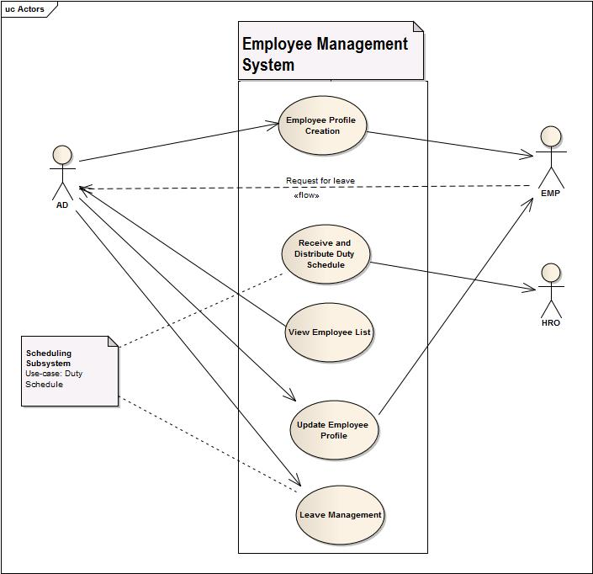
Fig : USE CASE diagram of Employee Management System

Slide 42
3.1: Employee Profile Creation (Use-Case Narrative)
USE CASE NAME | DEFINE ROUTE AND PRICE
USE CASE ID | 3.1
Priority | High
Primary Business Actor | EMP
External Receiver Actor | AD
Description | AD registers an EMP in the system
Trigger | AD

Slide 43
Typical Course Of Events
Actor Action | System Response
Step 1. Employee Joins the Hospital | Step 4. System Creates EMP profile
Step 2. Provides Information to AD
Step 3. AD insert information in System

Slide 44
Documentation of the use-case 3.1
Course of the events
Conclusion:
Concludes when a employee is adopted and all the information are gathered in the database.
Post-condition:
The employee profile is created and prepared for further use.
Implementation Issues:
A System GUI will be provided to entry a employee information which can be accessed by administrator.

Slide 45
3.2 Receive and Distribute Duty Schedule(Use-Case Narrative)
USE CASE NAME | DEFINE ROUTE AND PRICE
USE CASE ID | 3.2
Priority | MED
Primary Business Actor | HRO
External Receiver Actor | EMP
Description | HRO receives the duty schedule from the scheduling subsystem And distributes it among the EMP
Trigger | HRO

Slide 46
Typical Course Of Events
Actor Action | System Response
Step 1. HRO receives duty schedule from Scheduling subsystem
Step 2. HRO distributes them among employees

Slide 47
Documentation of the use-case 3.2
Course of the events
Conclusion:
Concludes when schedules are distributed to the employees.
Post-condition:
The employees are notified by some ways(sms or electrical screen).
Implementation Issues:
A routine type schedule will be created daily basis for doctors and employees by system and will be displayed on digital screen or notified by sms.

Slide 48
3.3 View Employee List (Use-Case Narrative)
USE CASE NAME | DEFINE ROUTE AND PRICE
USE CASE ID | 3.3
Priority | Low
Primary Business Actor | AD
External Receiver Actor
Description | AD can view the current EMP list
Trigger | AD

Slide 49
Typical Course Of Events
Actor Action | System Response
Step 1. AD wants to view the admitted PT list | Step 2 . System shows it

Slide 50
Documentation of the use-case 3.3
Course of the events
Conclusion:
When employee lists is shown on software GUI(with filter searching).
Post-condition:
Administrator can do permitted operations on employee (salary increment ,fire etc).
Implementation Issues:
All employee lists will be prepared and showed on the GUI based on(with or without filtering) searching and will be provided options for permitted changes.

Slide 51
3.4 Update Emp Profile (Use-Case Narrative)
USE CASE NAME | DEFINE ROUTE AND PRICE
USE CASE ID | 3.4
Priority | MED
Primary Business Actor | EMP
External Receiver Actor | AD
Description | AD can update information of EMP
Trigger | EMP

Slide 52
Typical Course Of Events
Actor Action | System Response
Step 1. AD inserts updated information | Step 2. System Updates it

Slide 53
Documentation of the use-case 3.4
Course of the events
Conclusion:
Concludes when changes made by administrator is updated.
Post-condition:
The new information about the employees will now exist in the system and concerned employee will be notified.
Implementation Issues:
Administrator views and changes employee information and updates the employee information and employee will be notified by sms.

Slide 54
3.5 Leave Management (Use-Case Narrative)
USE CASE NAME | DEFINE ROUTE AND PRICE
USE CASE ID | 3.5
Priority | High
Primary Business Actor | EMP
External Receiver Actor | AD
Description | AD has to approve leave for an EMP and Updates DB as so
Trigger | EMP

Slide 55
Typical Course Of Events
Actor Action | System Response
Step 1. EMP requests for Leave | Step 3. If accepted then Profile is updated
Step 2. AD chooses to accept or deny | Step 4. Updated info is sent to Scheduling subsystem

Slide 56
Documentation of the use-case 3.5
Course of the events
Conclusion:
When employee absence is adapted in the system.
Post-condition:
System scheduling and other things will be updated.
Implementation Issues:
If administrator accepts the leave prayer then he/she will be notified by sms and system scheduling will be done adapted.

Slide 57
3.6 Prepare EMP list (Use-Case Narrative)
USE CASE NAME | DEFINE ROUTE AND PRICE
USE CASE ID | 3.6
Priority | MED
Primary Business Actor | AD
External Receiver Actor
Description | AD prepares the EMP list
Trigger | AD

Slide 58
Typical Course Of Events
Actor Action | System Response
Step 1. AD asks the system to prepare a list of current EMP | Step 2. System produces the list of EMP who are currently working in the hospital

Slide 59
Documentation of the use-case 3.6
Course of the events
Conclusion:
Concludes when information about employees is currently stored and ready to be searched.
Post-condition:
The administrator is notified about the current employees.
Implementation Issues:
List of employee information is stored in database and prepared for filter searching.

Slide 60
4. Diagnostic Center System
Use-Case Glossary:
Use-case ID>Name | Description | Participant Actors and roles
4.1>Receive request | RCP receives a diagnostic test request from PT. | RCP PT
4.2>Collect sample | DCA collects diagnostic sample from PT. | DCA PT
4.3>Prepare Report | DOC prepares report according to the sample and handles it to the RCP. | DOC RCP
4.4>Prepare Bill | CLK prepares bill for the patient | CLK
4.5>Delivery Report | RCP delivers the report to the PT. | PT RCP

Slide 61
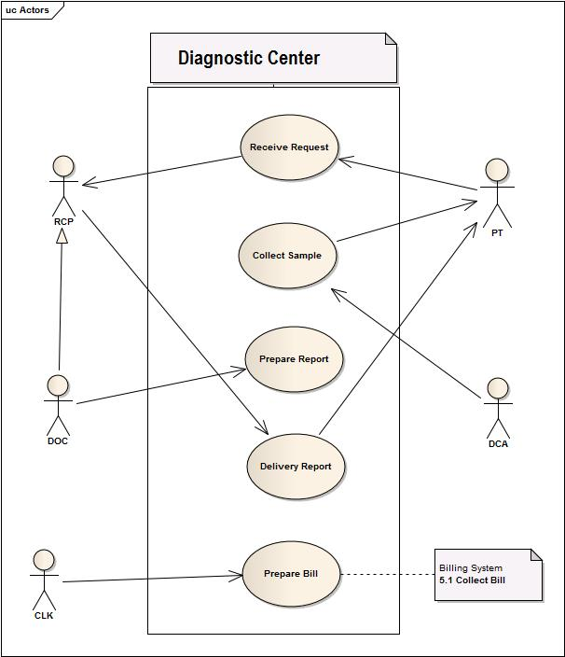
Fig : USE CASE diagram of Diagnostic Center System

Slide 62
4.1 Receive Request (Use-Case Narrative)
USE CASE NAME | DEFINE ROUTE AND PRICE
USE CASE ID | 4.1
Priority | High
Primary Business Actor | DOC , PT,
External Receiver Actor | DCM, RCP
Description | DOC/PT requests medical test and DCM/RCP accepts those
Trigger | DOC/PT

Slide 63
Typical Course Of Events
Actor Action | System Response
Step 1. DOC / PT request for test
Step 2. DCM / RCP accepts those

Slide 64
Documentation of the use-case 4.1
Course of the events
Conclusion:
Concludes when medical list for requested patients is arrived and granted.
Post-condition:
Concludes when medical list for requested patients is arrived and granted.
Implementation Issues:
A list of test a patient is sent from doctor prescription and received by diagnostic center manager.

Slide 65
4.2 Collect Sample (Use-Case Narrative)
USE CASE NAME | DEFINE ROUTE AND PRICE
USE CASE ID | 4.2
Priority | High
Primary Business Actor | PT
External Receiver Actor | DCA
Description | DCA collects sample from PT
Trigger | DCA

Slide 66
Typical Course Of Events
Actor Action | System Response
Step 1. DCA takes sample of the patient

Slide 67
Documentation of the use-case 4.2
Course of the events
Conclusion:
A list of test a patient is sent from doctor prescription and received by diagnostic center manager.
Post-condition:
The sample is ready to be tested and prepare report

Slide 68
4.3 Prepare Report (Use-Case Narrative)
USE CASE NAME | DEFINE ROUTE AND PRICE
USE CASE ID | 4.3
Priority | High
Primary Business Actor | DOC , DCA
External Receiver Actor
Description | DOC/ DCA prepares report
Trigger | DOC/DCA

Slide 69
Typical Course Of Events
Actor Action | System Response
Step 1. DOC / DCA prepares report

Slide 70
Documentation of the use-case 4.3
Course of the events
Conclusion:
Finishes when reports are prepared for patient delivery and uploaded to patient profile database.
Post-condition:
Patients are notified that reports are ready.
Implementation Issues:
Digital copy of reports will be sent to patient profile.

Slide 71
4.4 Prepare Bill (Use-Case Narrative)
USE CASE NAME | DEFINE ROUTE AND PRICE
USE CASE ID | 4.4
Priority | High
Primary Business Actor | RCP
External Receiver Actor | PT
Description | RCP prepares the bill and gives to PT
Trigger | RCP

Slide 72
Typical Course Of Events
Actor Action | System Response
Step 1. RCP prepares bill | Step 3. System updates PT account
Step 2. bill is added to PT account

Slide 73
Documentation of the use-case 4.4
Course of the events
Conclusion:
Digital copy of reports will be sent to patient profile.
Post-condition:
Tests are sent to be added to the total costs for concerned patient profile.
Implementation Issues:
Diagnostic center assistant entries the costs and system will calculate the others.

Slide 74
4.5 Delivery Report (Use-Case Narrative)
USE CASE NAME | DEFINE ROUTE AND PRICE
USE CASE ID | 4.5
Priority | High
Primary Business Actor | RCP
External Receiver Actor | PT
Description | RCP delivers report to PT
Trigger | PT

Slide 75
Typical Course Of Events
Actor Action | System Response
Step 1. RCP checks for dues status | Step2. System provides dues status
Step 3. RCP delivers the report to PT | Step 4. PT also emails the report

Slide 76
Documentation of the use-case 4.5
Course of the events
Conclusion:
When patients are handed the reports to their email address or hard copy.
Implementation Issues:
Prepared digital copy of the reports will be sent to their email or the hard copy will be given.

Slide 77
5. Billing System
Use-Case Glossary:
Use-case ID>Name | Description | Participant Actors and roles
5.1>Collect Bill Information | CLK collects all billing information from different sub system | CLK
5.2>Receive bill | PT gives total bill to CLK | PT,CLK
5.3> Produce Receipt | CLK produces receipt for patient | CLK

Slide 78
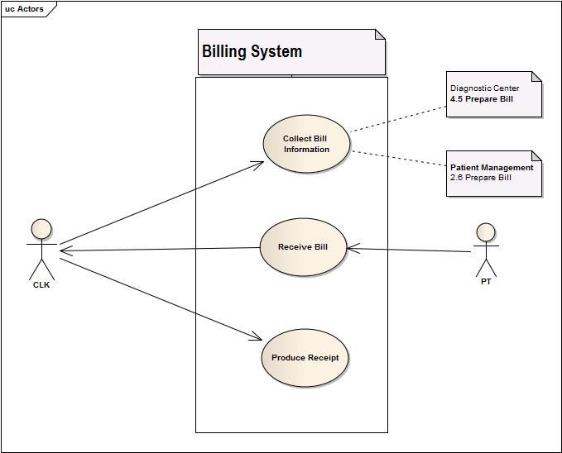
Fig : USE CASE diagram of Billing System

Slide 79
5.1 Collect Bill information from other subsystems (Use-Case Narrative)
USE CASE NAME | DEFINE ROUTE AND PRICE
USE CASE ID | 5.1
Priority | High
Primary Business Actor | CLK
External Receiver Actor
Description | CLK collects all bills from Patient profile
Trigger | CLK

Slide 80
Typical Course Of Events
Actor Action | System Response
Step 1. CLK checks for all bills in PT account | Step 2.System shows the pt account
 | Step 2. System collects all bills and prepare them

Slide 81
Documentation of the use-case 5.1
Course of the events
Conclusion:
Concludes when all costs and costs sent from other systems are summed up.
Post-condition:
System will prepare full bill list.
Implementation Issues:
All services charges,doctor fees,cabin or bed cost(depends on how long patients stayed),diagnostic costs are added.

Slide 82
5.2 Receive Bill (Use-Case Narrative)
USE CASE NAME | DEFINE ROUTE AND PRICE
USE CASE ID | 5.2
Priority | High
Primary Business Actor | PT
External Receiver Actor | CLK
Description | PT pays bill to CLK
Trigger | PT

Slide 83
Typical Course Of Events
Actor Action | System Response
Step1. PT pay bill to CLK | Step 2. System updates PT account

Slide 84
Documentation of the use-case 5.2
Course of the events
Conclusion:
When patient profile will be updated as all costs paid.
Post-condition:
System will provide the patient discharge grant through administrator.
Implementation Issues:
Costs paid by the patients will be sent to patient profile to be cleared up and remove dues status.

Slide 85
5.3 Produce Receipt (Use-Case Narrative)
USE CASE NAME | DEFINE ROUTE AND PRICE
USE CASE ID | 5.3
Priority | High
Primary Business Actor | CLK
External Receiver Actor | PT
Description | CLK produces receipt and gives it to PT
Trigger | CLK

Slide 86
Typical Course Of Events
Actor Action | System Response
Step 1. CLK asks system for receipt | Step 2. System prints a receipt

Slide 87
Documentation of the use-case 5.3
Course of the events
Conclusion:
All costs or bill lists are printed by the system
Post-condition:
Patients received money receipt with all costs paid or unpaid if patients want to see bill list.
Implementation Issues:
All types of costs from different sources are listed in a form and thus generate electrically printed receipt.

Slide 88
6. Scheduling System
Use-Case Glossary:
Use-case ID>Name | Description | Participant Actors and roles
6.1>Active Employee List | AD gets the active employee list | AD
6.2>Duty Schedule | AD specifies duty schedules of all employees | AD

Slide 89
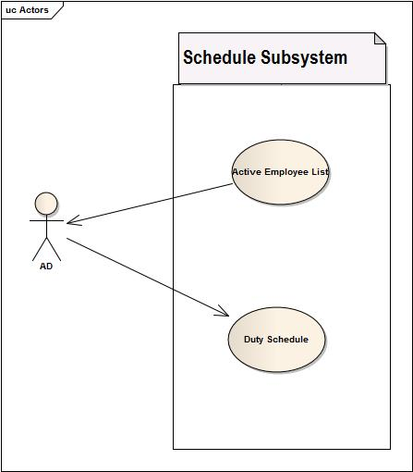
Fig : USE CASE diagram of Billing System

Slide 90
6.1 Receive Active Employee (Use-Case Narrative)
USE CASE NAME | DEFINE ROUTE AND PRICE
USE CASE ID | 6.1
Priority | Med
Primary Business Actor | AD
External Receiver Actor
Description | System receive active employee list
Trigger | AD

Slide 91
Typical Course Of Events
Actor Action | System Response
 | Step 1.Receive the list of active employees

Slide 92
Documentation of the use-case 6.1
Course of the events
Conclusion:
Concludes by preparing a list of employee who are currently active.
Post-condition:
All active employees will be ready to be scheduled.
Implementation Issues:
A list will be prepared by system depending on on-leave status of the employee and other criteria's.

Slide 93
6.2 Duty Schedule (Use-Case Narrative)
USE CASE NAME | DEFINE ROUTE AND PRICE
USE CASE ID | 6.2
Priority | High
Primary Business Actor | AD
External Receiver Actor
Description | System produces duty schedule
Trigger | AD

Slide 94
Typical Course Of Events
Actor Action | System Response
 | Step 1. Produce a work schedule for all emp
 | Step 2. Send it to HRO

Slide 95
Documentation of the use-case 6.2
Course of the events
Conclusion:
Concludes when all duty schedule are prepared checking employees information.
Post-condition:
Concerned employee will be notified for their duties.
Implementation Issues:
A digital screen will show schedule list.Also employee will be notified by sms according to their tasks.

Slide 96

QUESTIONS???

Slide 97
Thank You

